Slide 1


UNIVERSITY OF PADUA
UNIVERSITA’ DEGLI STUDI DI PADOVA
Designing an accessibility learning toolkit -
Bridging the gap between guidelines and implementation
Department of Mathematics “Tullio Levi-Civita”
Master Degree in Computer Science
Graduate: Gabriel Rovesti (ID: 2103389)
Supervisor: Prof. Ombretta Gaggi
Graduation Session: 25/07/2025

Slide 2
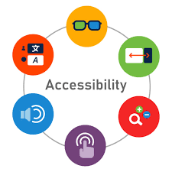

First and not least: Mobile accessibility
Definition: Ability for users to fully perceive, understand, navigate, and interact with digital content regardless of capabilities
The mobile reality:
1.3 billion people worldwide live with disabilities (WHO, 2023)
Mobile-first era: 6.8 billion smartphone users globally
Mobile interfaces create new accessibility barriers for assistive technology users
G. Rovesti - Designing an accessibility learning toolkit
2/17

Slide 3


First and not least: Mobile challenges
Touch interaction barriers:
Target size not standardized and difficult to use
Complex gestures exclude motor-impaired users
One-handed operation limitations
Mobile context issues:
Small screens affect content hierarchy
Orientation changes disrupt navigation
Performance impact on battery and processing
G. Rovesti - Designing an accessibility learning toolkit
3/17

Slide 4
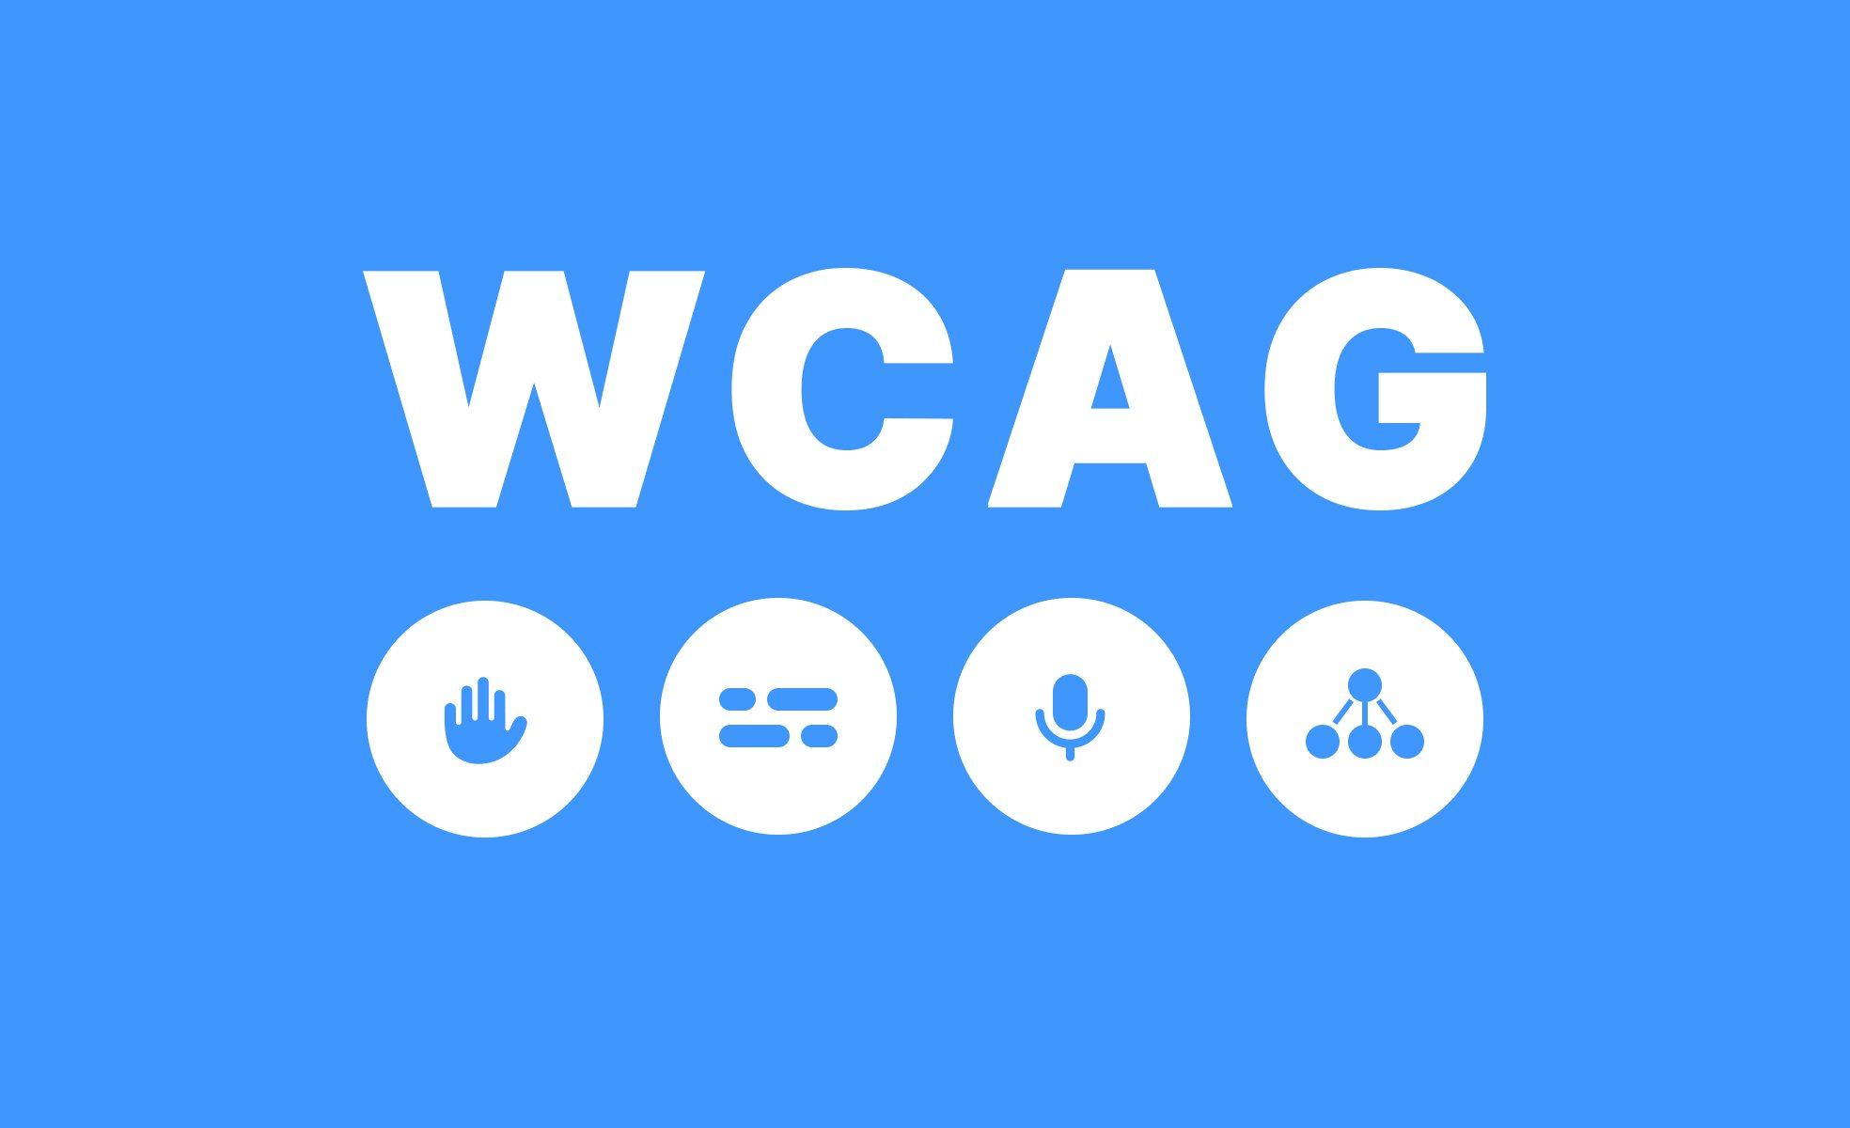

Accessibility guidelines gap
Current standards:
WCAG 2.2 (2023): 4 principles, 3 levels of conformance - web-focused
MCAG (2015): Mobile adaptation - based on WCAG 2.0
WCAG2Mobile (2025): Recent mobile guidance - interpretations only
The problem:
Outdated foundation: MCAG missing WCAG 2.1/2.2 mobile criteria
Implementation void: No practical framework for mobile developers
Knowledge fragmentation: Scattered resources, unclear costs
Result: Mobile developers lack comprehensive accessibility implementation guidance
G. Rovesti - Designing an accessibility learning toolkit
4/17

Slide 5
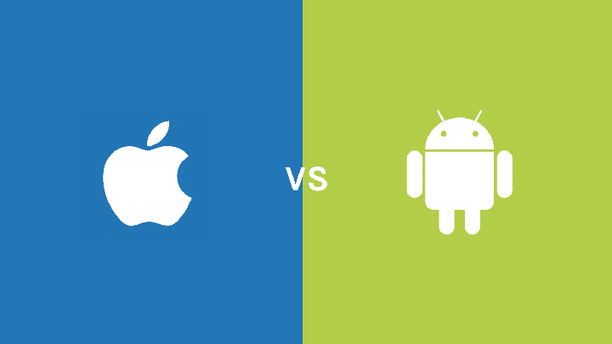
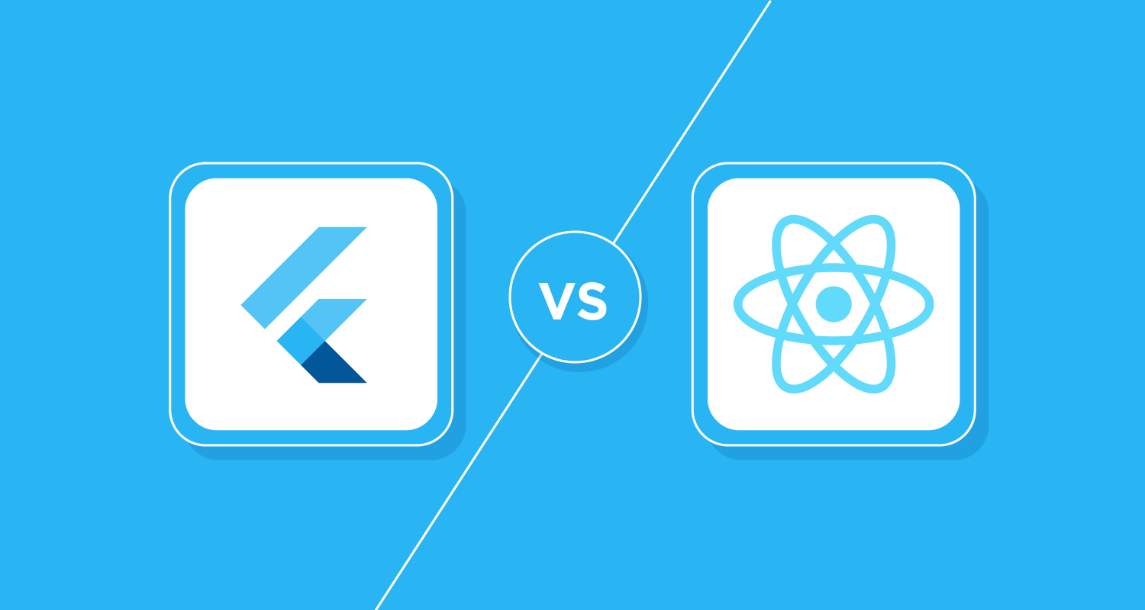
Platform implementation gap
Platform differences:
iOS: VoiceOver, Voice Control, Switch Control
Android: TalkBack, Switch Access, Keyboard navigation
Framework responses:
Flutter: Single accessibility tree, platform adaptation layer
React Native: Platform-specific accessibility props, native bridge
The developer challenge:
Budai (2024): Tested component accessibility → fragmented knowledge
Gap identified: No comprehensive learning resource bridging platforms
G. Rovesti - Designing an accessibility learning toolkit
5/17

Slide 6
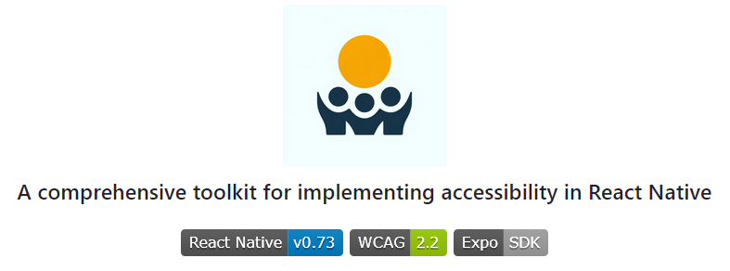
AccessibleHub – Bridging the gap
Research Questions as standard approach:
RQ1: Are React Native components accessible by default?
RQ2: Can non-accessible components be made accessible?
RQ3: What's the implementation cost (code overhead)?
AccessibleHub: React Native application tested on both Android and iOS serving as interactive accessibility manual for mobile developers
Every screen analyzed for accessibility patterns and costs
Educational platform bridging theory to practice
G. Rovesti - Designing an accessibility learning toolkit
6/17

Slide 7
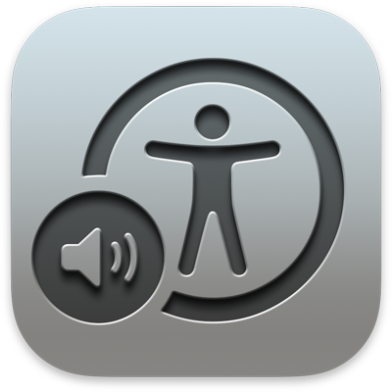

AccessibleHub – Overview
Core application sections:
🔧 Accessible Components: UI implementations with copyable code
📚 Best Practices: Educational content on accessibility challenges
🛠️ Tools Screen: Resource catalog for testing and evaluation
📊 Framework Comparison: Evidence-based evaluation methodology
👥 Community Integration: Social learning and collaborative resources
Research innovation: Every screen analyzed as case study
20+ components tested with TalkBack and VoiceOver
Cross-platform validation ensuring patterns work universally
G. Rovesti - Designing an accessibility learning toolkit
7/17

Slide 8
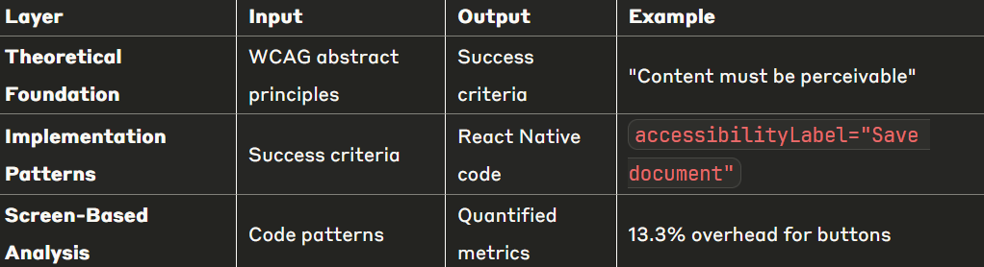
Systematic analysis approach
The transformation challenge: WCAG guidelines are abstract and difficult to implement directly in mobile code
Basic workflow:
Abstract WCAG → Implementation Patterns →
Quantified Metrics → Educational Platform
G. Rovesti - Designing an accessibility learning toolkit
8/17

Slide 9
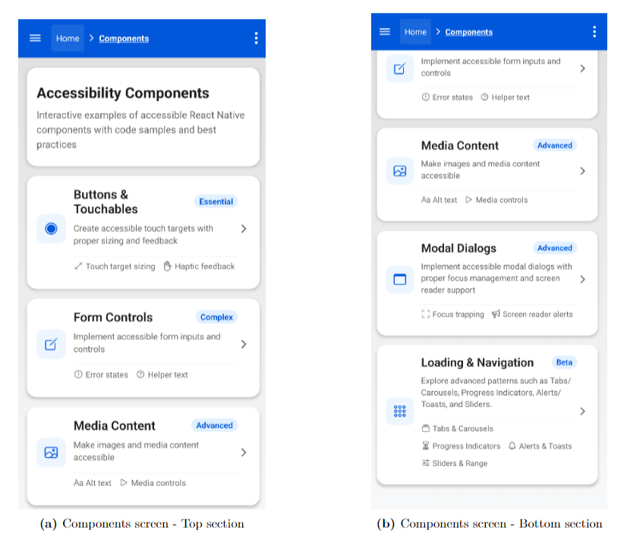
Systematic analysis – Example (1)
G. Rovesti - Designing an accessibility learning toolkit
9/17

Slide 10
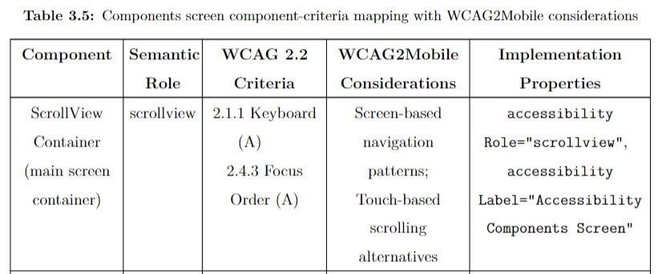
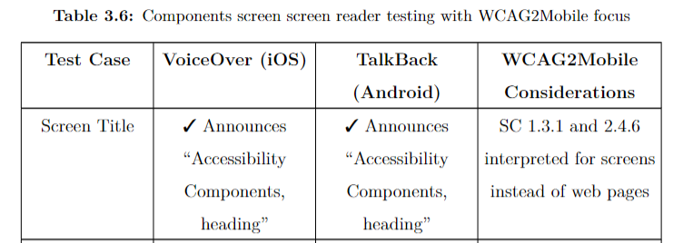
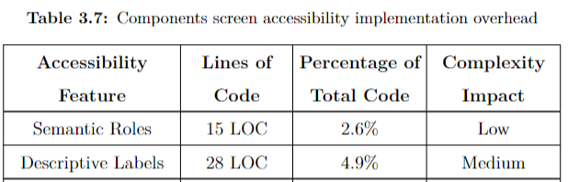
Systematic analysis – Example (2)
G. Rovesti - Designing an accessibility learning toolkit
10/17

Slide 11
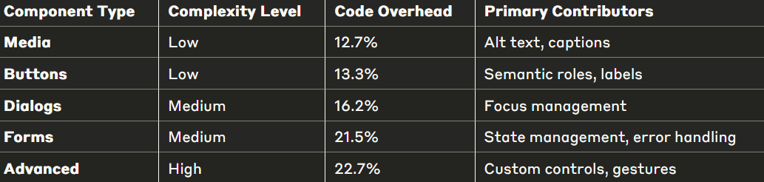
Accessibility implementation costs
Key finding: Accessibility implementation requires 12-23% additional code across component types
Critical insights:
Even complex components stay under 25%
Correlation between interaction complexity and implementation cost
Manageable overhead for significant usability improvements
First quantitative framework for mobile accessibility cost assessment
G. Rovesti - Designing an accessibility learning toolkit
11/17

Slide 12
Beyond WCAG: Extended Principles
Extending WCAG Principles:
🔄 Multi-dimensional Evaluation: Beyond compliance - includes empirical testing + real-world usability
🔍 Methodology Transparency: Clear evaluation documentation, test procedures, accountability
📚 Academic Grounding: Peer-reviewed research integration, formal standards connection
📊 Progressive Disclosure: Layered complexity for different developer skill levels
👥 Social Learning Integration: Community-driven knowledge sharing
Result: First comprehensive developer resource bridging accessibility theory with mobile practice
G. Rovesti - Designing an accessibility learning toolkit
12/17

Slide 13
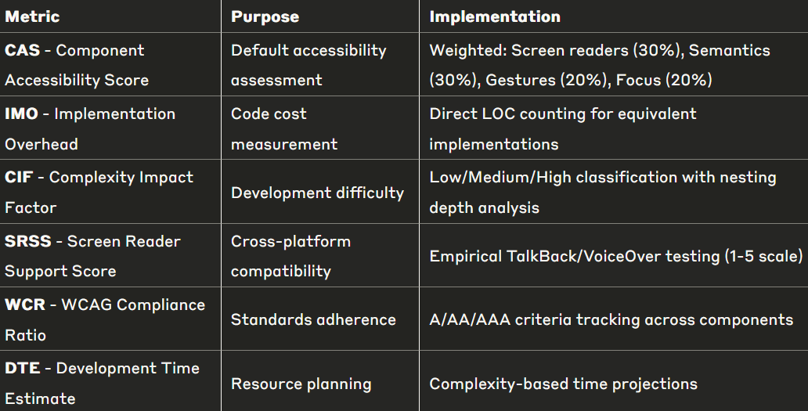
Formal evaluation metrics
Innovation: First structured methodology for quantifying mobile accessibility implementation across frameworks
G. Rovesti - Designing an accessibility learning toolkit
13/17

Slide 14
Framework comparison
Architecture differences:
React Native: Property-based model (accessibilityLabel, accessibilityRole)
Flutter: Widget-based approach (explicit Semantics wrappers)
Implementation findings:
React Native: Higher implementation overhead, better native integration
Flutter: Lower baseline accessibility, requires more manual implementation
Code verbosity: React Native more concise for accessibility features
Cross-Platform Insights: Framework selection significantly impacts accessibility implementation complexity and developer experience
G. Rovesti - Designing an accessibility learning toolkit
14/17

Slide 15
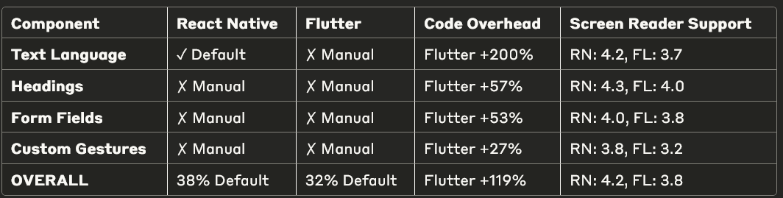
Framework comparison results (1)
Key Patterns Identified:
Text language declaration: Largest overhead difference (Flutter +200%)
Custom gestures: Smallest gap (Flutter +27%) - both frameworks struggle
Default accessibility: React Native provides more out-of-box features (38% vs 32%)
Screen reader consistency: React Native scores higher across all component types
G. Rovesti - Designing an accessibility learning toolkit
15/17

Slide 16
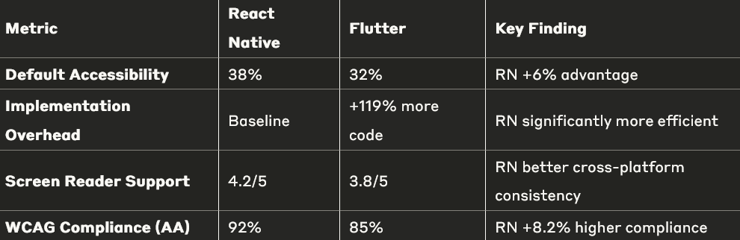
Framework comparison results (2)
Critical insights:
React Native: Property-based model - 45% less code, better platform integration
Flutter: Widget-based model - more explicit semantics, higher implementation cost
Framework selection significantly impacts accessibility development efficiency
G. Rovesti - Designing an accessibility learning toolkit
16/17

Slide 17


Research impact and conclusions
Key contributions:
First quantitative framework for mobile accessibility implementation cost assessment
Systematic methodology transforming abstract WCAG principles into practical code patterns
Practical impact:
Developers: Clear cost-benefit analysis for accessibility implementation prioritization
Organizations: Evidence-based framework selection guidance for accessible mobile projects
Academic community: Reproducible methodology for accessibility evaluation
G. Rovesti - Designing an accessibility learning toolkit
17/17

